Slide 1
Company presentation
CEO Christian Wolflehner

Slide 2
Company
Independent Contract Research Organisation (Expert – CRO)
Operating in the pharmaceutical, biotechnology, medical device and healthcare industry
Continuous growth with headquarters in Munich (Germany), Vienna and Adlwang (Austria)
Certified according to EN ISO 9001:2015
1993
Founding in Vienna by Dr. Robert Heinz as Dr. Robert Heinz & Partner GmbH
2007
Christian Wolflehner becomes General Manager
Opening of the geographically favourable location in Adlwang
2010
Christian Wolflehner becomes the owner of the company
2013
Expansion to Munich/Germany
2017
Fusion of company names to CW-Research & Management GmbH

Slide 3
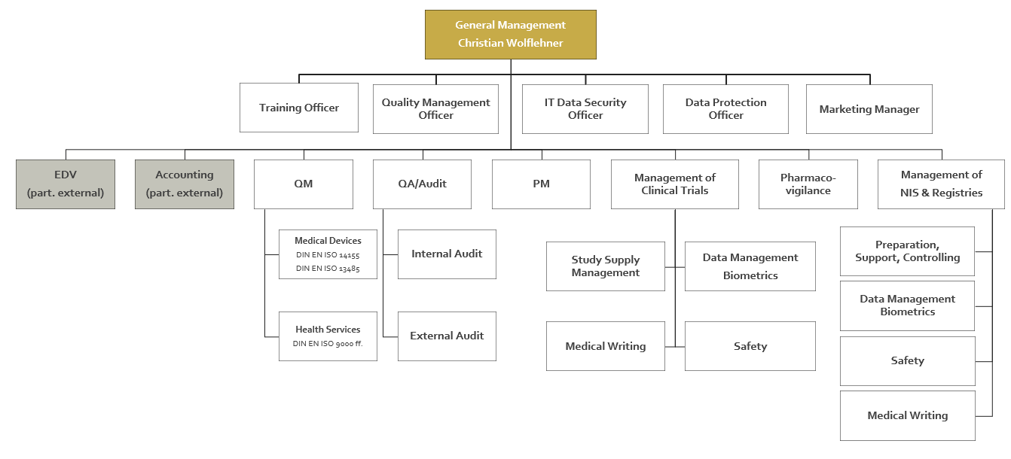
Organisation Chart

Slide 4
Locations
Your reliable partner since 1993 in
GERMANY & AUSTRIA
CW – Research & Management GmbH
D-81829 Munich
Konrad-Zuse-Platz 8
A-1190 Vienna
Heiligenstädter Lände 29
A-4541 Adlwang
Nelkenstraße 6, Oberösterreich
Together with our cooperation partners we manage your project throughout
EUROPE

Slide 5
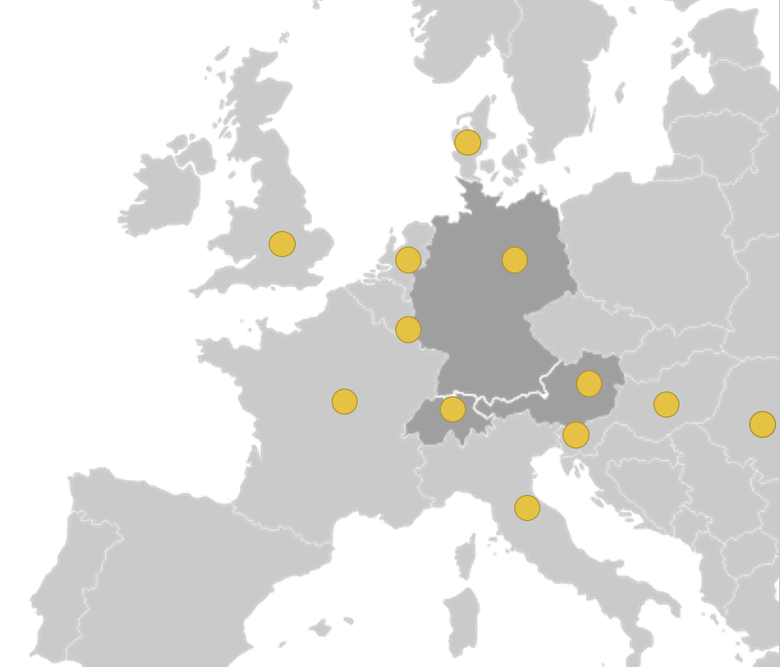
Projects
team of experienced specialists
responsible for the realization of numerous projects mainly in Austria and Germany as well as for projects with selected and quality-checked cooperation partners in numerous European countries
Expertise combined with many years of experience as the basis for our corporate philosophy and our success

Slide 6
Our Services
Study Design
Regulatory Activities
Site Management
Project Management
Monitoring (on-site & risk-based)
Biometrics & Coding
Date Management
Medical Writing
e-Data Capture (EDC)
Quality Assurance / Audit
Safety / Pharmacovigilance
Quality & Risk Management
Consulting Services
© bearfotos

Slide 7
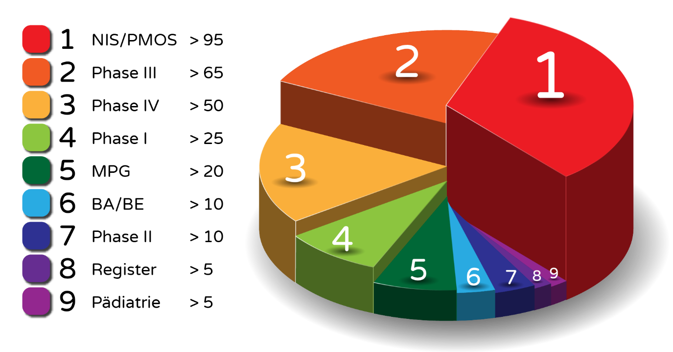
Experience
Clinical trials phase I to IV
Clinical trials with medical devices
Non-Interventional Studies (NIS)
Post Authorization Safety Studies (PASS)
Post Marketing Observational Studies (PMOS)
Questionnaire investigations
Register studies
Retrospective data evaluations
Nutrition studies
Total: > 315 Projects since 2000

Slide 8
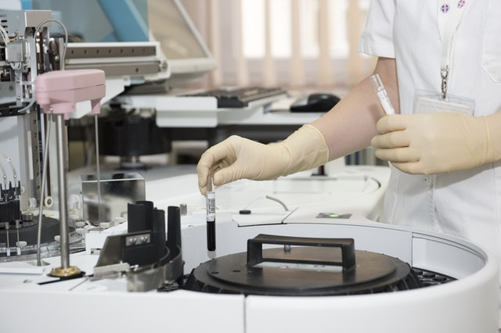
Indications
Neurology
Alzheimer‘s disease
Depression
Multiple sclerosis
Parkinson‘s disease
Obesity
Oncology
Breast carcinoma
Lung cancer
Melanoma
Ovarian carcinoma
Pancreas carcinoma
Prostate carcinoma
Pulmonary carcinoma
Ophthalmology
Oral surgery
Orthopedics
Osteoporosis
Otolaryngology
Pulmonology
Rheumatology
Surgery
Transplantation
Medicinal products
Allergy
Asthma
Cardiology
COVID-19
Dermatology
Diabetes
Fat metabolism
Fibrocystic breast changes
Gastroenterology
Hematology
Hepatology
Immunology / Vaccines
Metabolic diseases
Nephrology
Medical Devices
Dental diseases
Laboratory diagnostics / IVD
Medical Imaging
Neurology
Ophthalmology
Orthopedics
Otorhinolaryngology

Slide 9
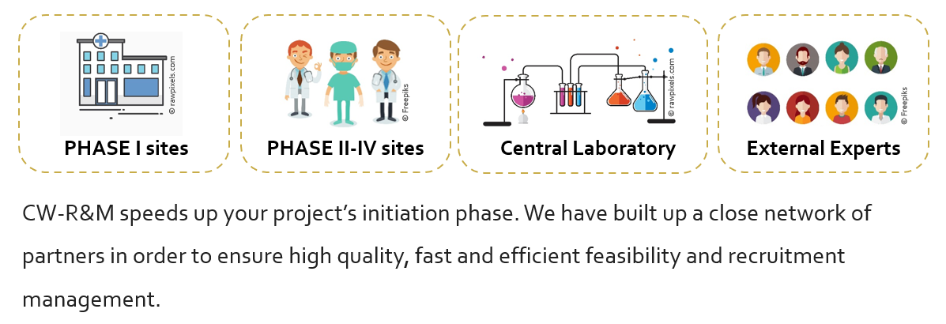
Close Cooperation with

Slide 10
Why CW-Research & Management?
FLAT HIERARCHY
Our staff works under a flat hierarchy with short decision-making channels. A back-up solution ensures no overloads and quick support for study management. Working with CW-R&M means to receive only high quality services.
DEDICATED START-UP TEAM
We have a group of specialized experts devoted to short contract negotiation, document submission and study initiation timelines.

Slide 11
Experience
Focused order processing
High professional and social competence
Punctuality
Effectiveness, Efficiency
Knowledge Networking (QM - Clinical Research)
Individuality & Flexibility
Continuity

